Slide 1
Workflow For Shell Localization
CSE 360 - Group 09

Slide 2
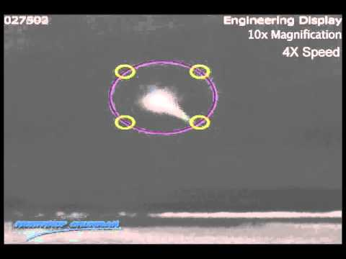
Get The Thermal Video Footage

Slide 3
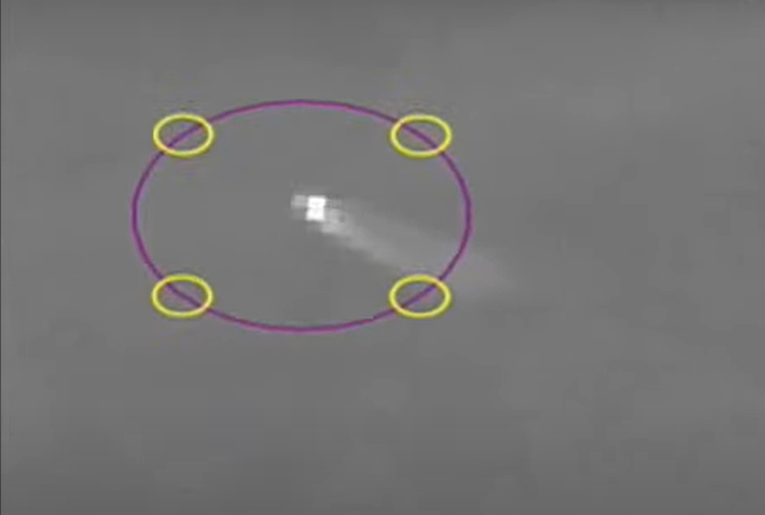
Get The Target Frame
Using FFMPEG & AI

Slide 4

Filtering - Detect Just The Blue Balls

Slide 5
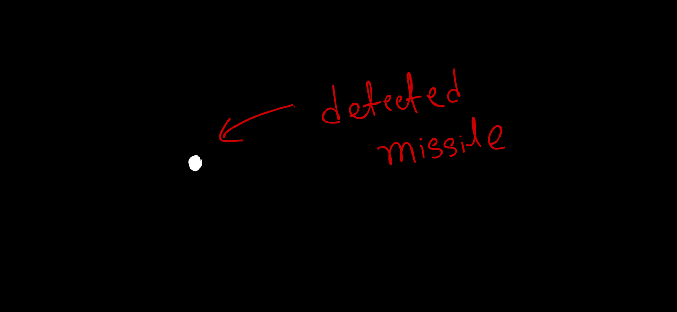
Filter The Target Frame

Slide 6
Get The Altitude Of The Drone
From the drone module we can easily get to know the altitude of the drone

Slide 7
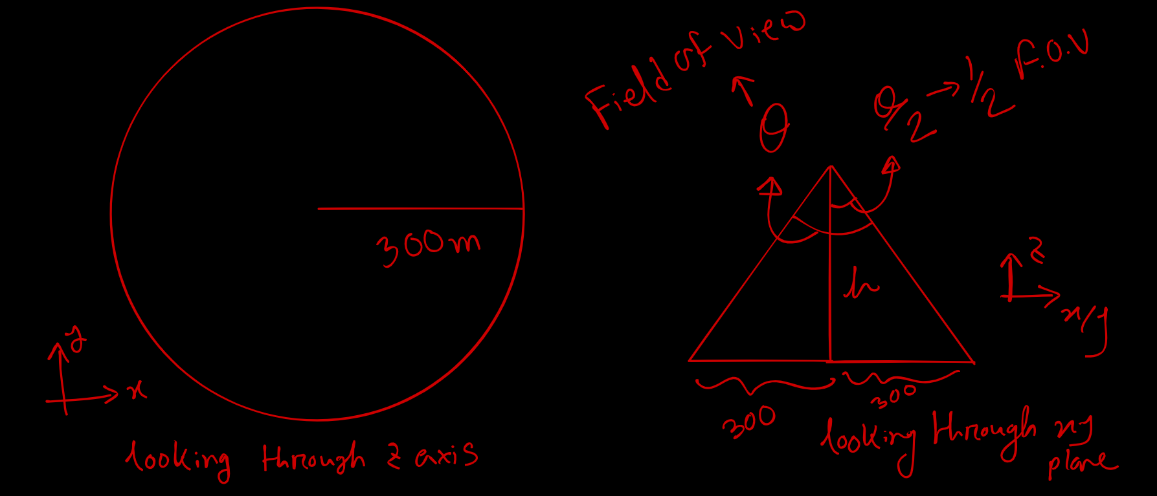
Where To Place The Drone ?

Slide 8
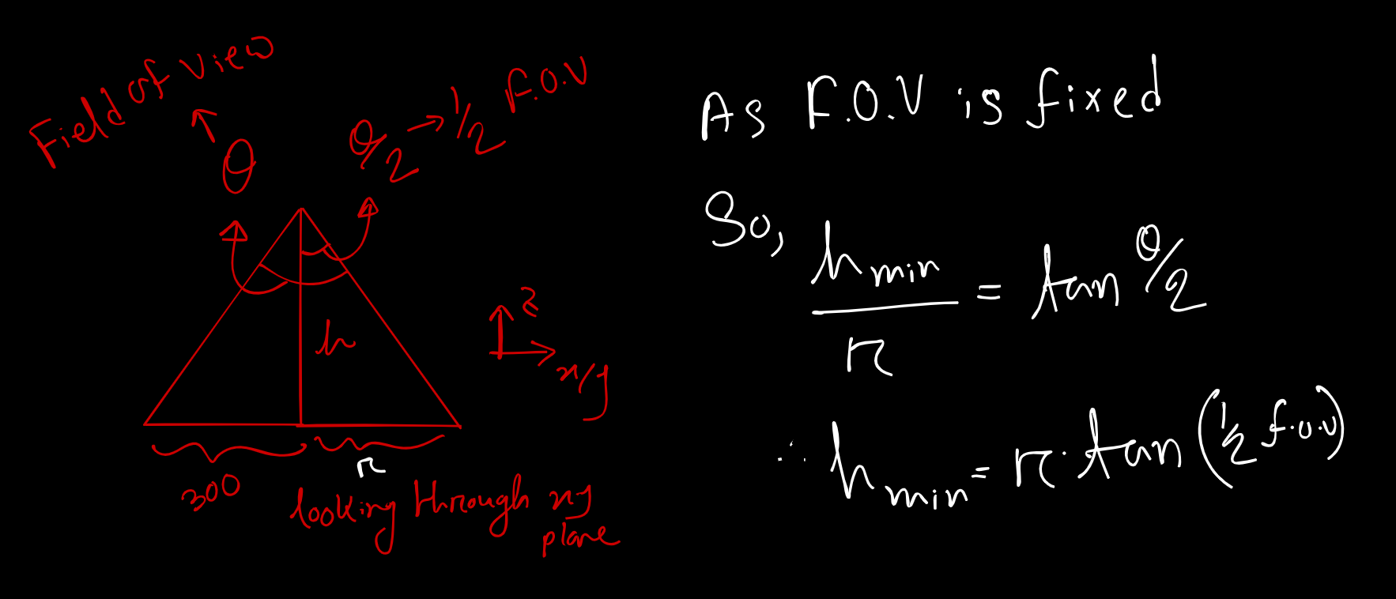
Where To Place The Drone ?

Slide 9
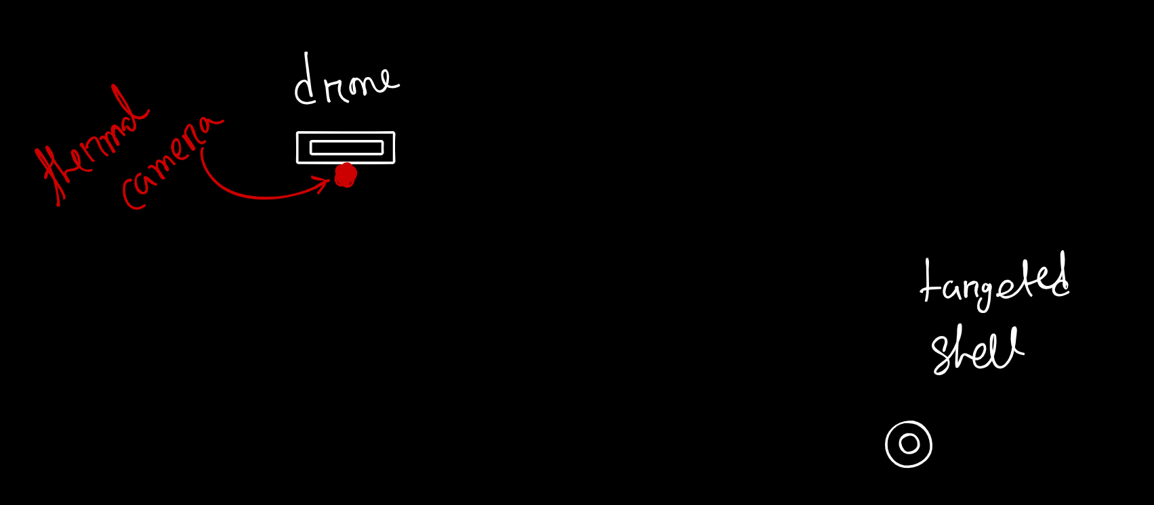
Get The Angle

Slide 10
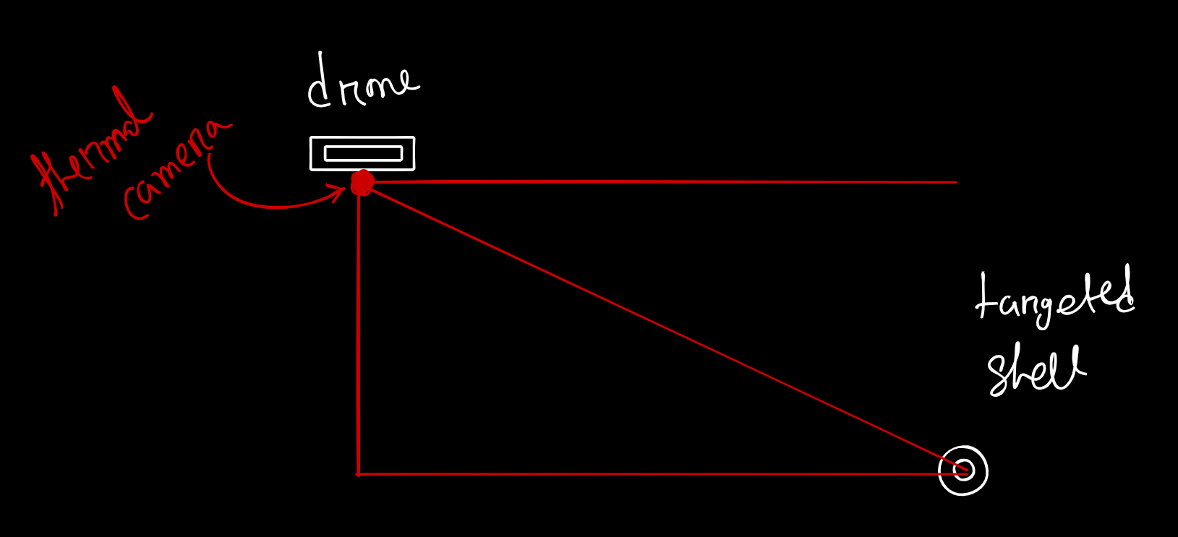
Get The Angle

Slide 11
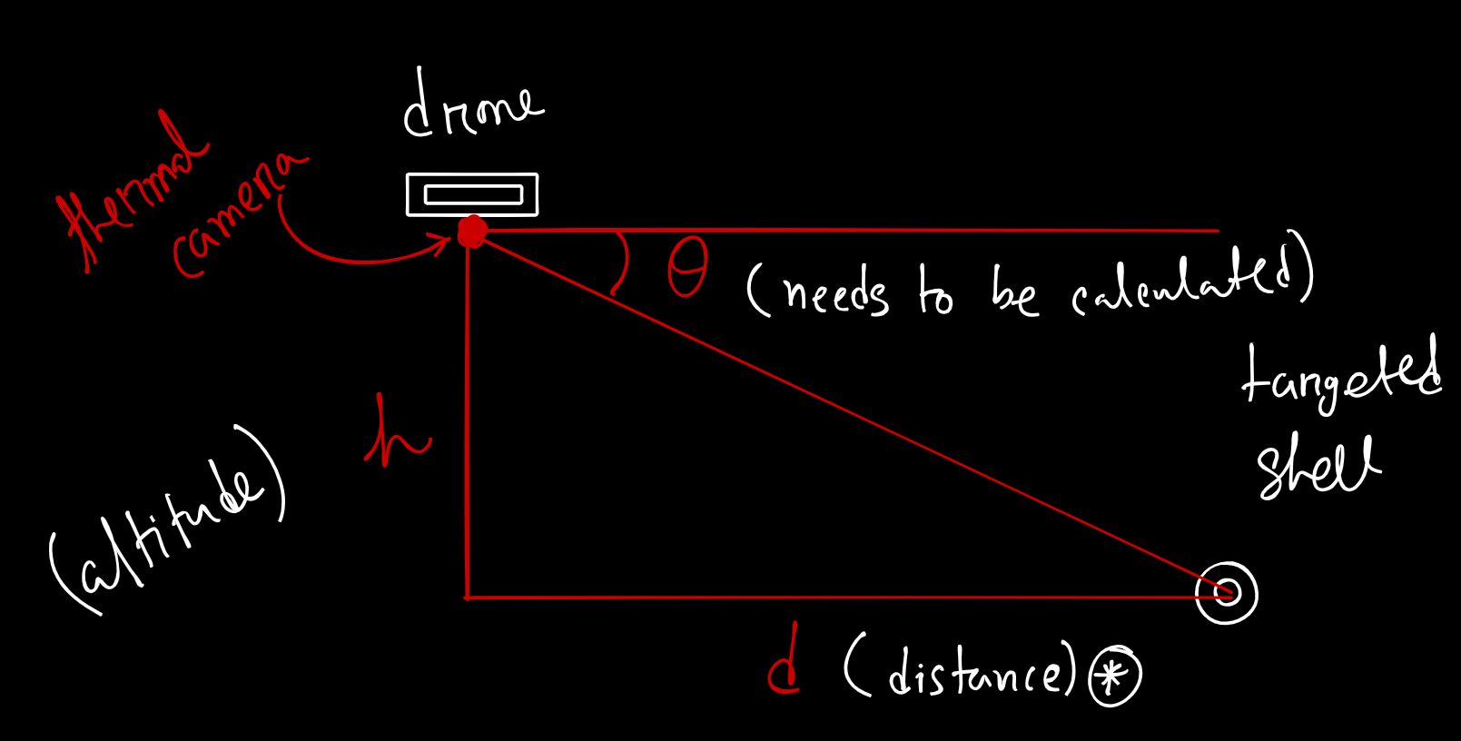
Get The Angle

Slide 12
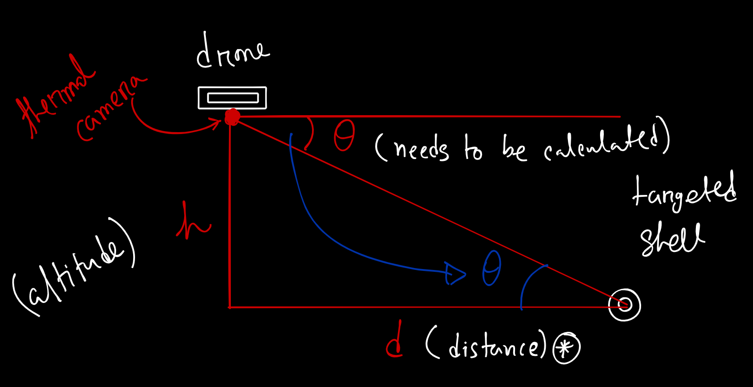
Get The Angle

Slide 13
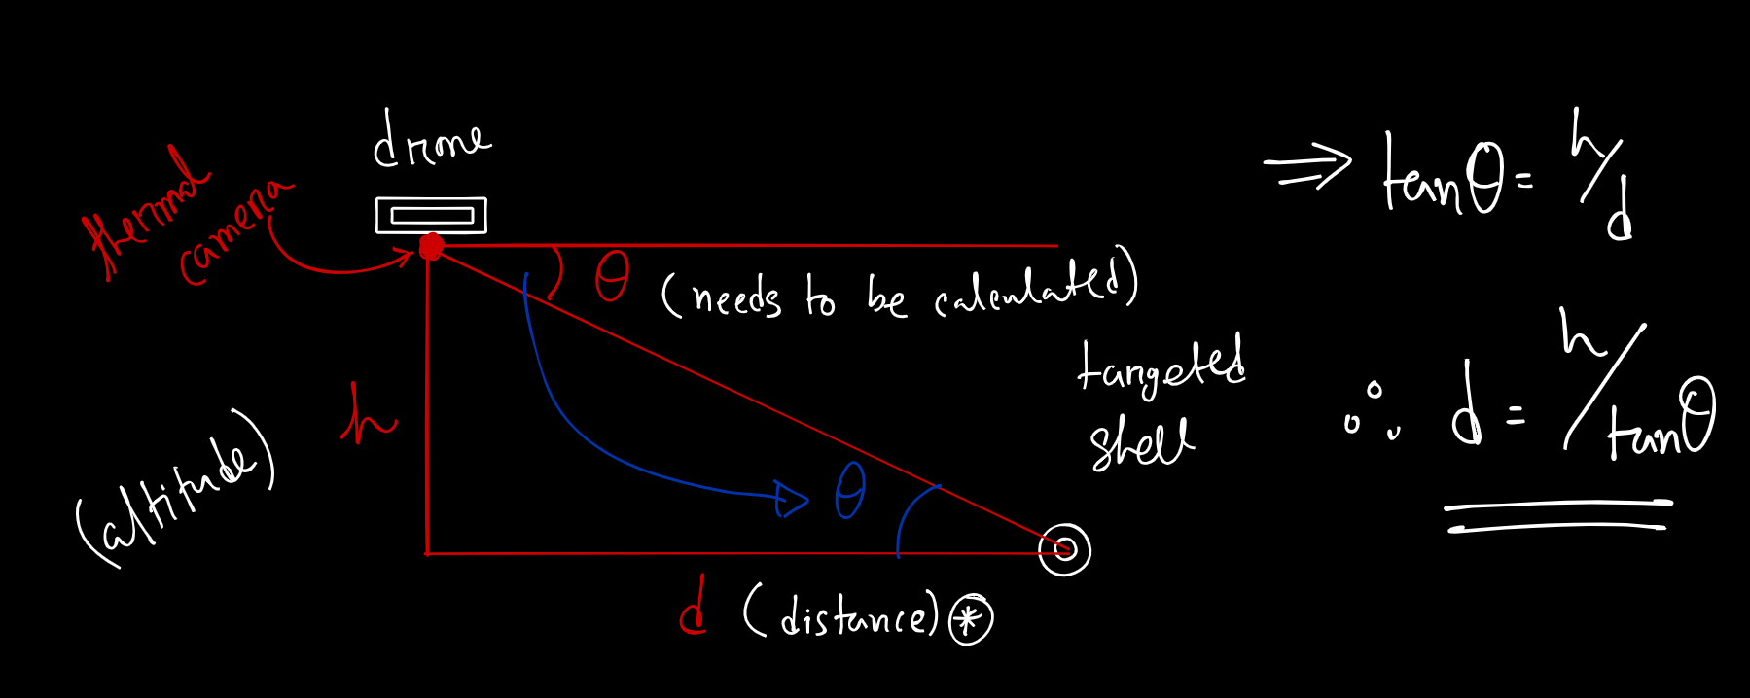
Get The Distance

Slide 14
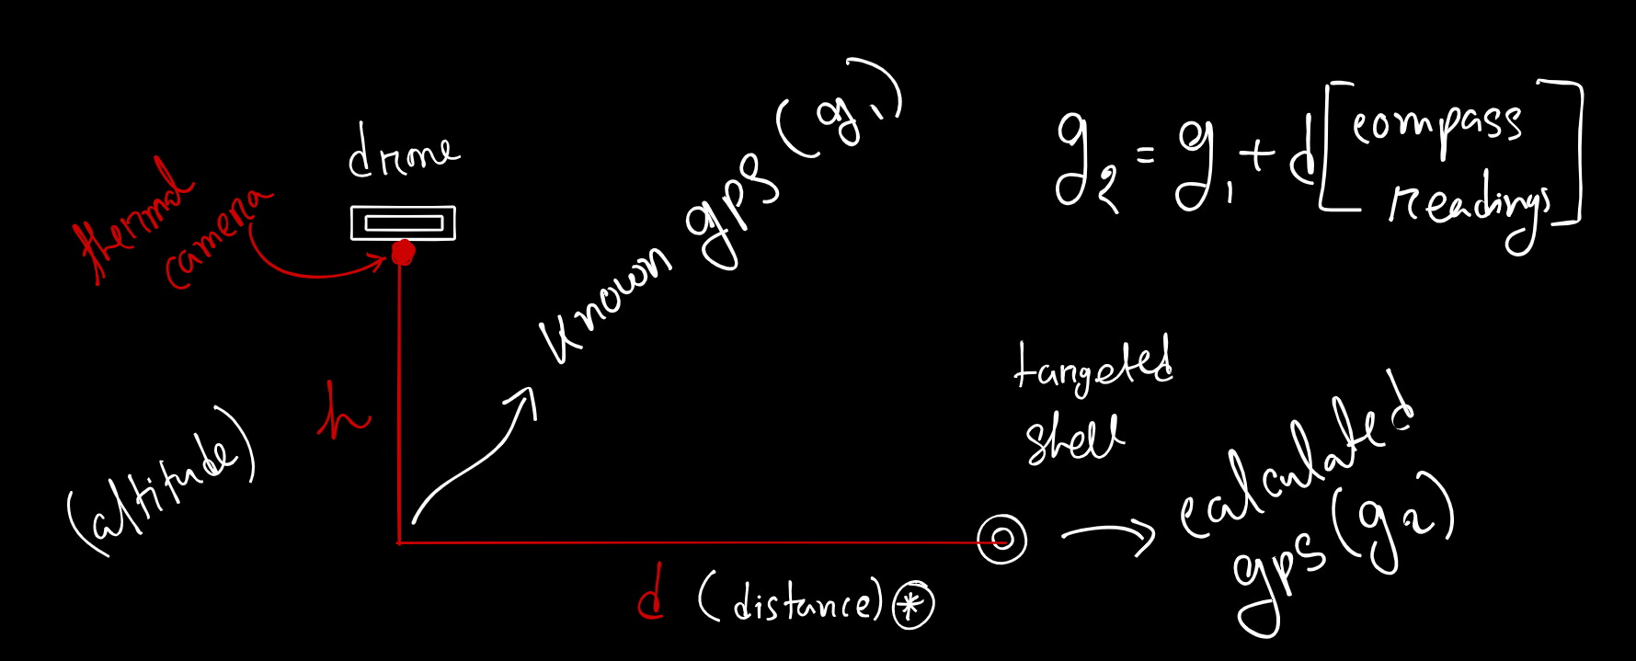
Get The GPS

Slide 15
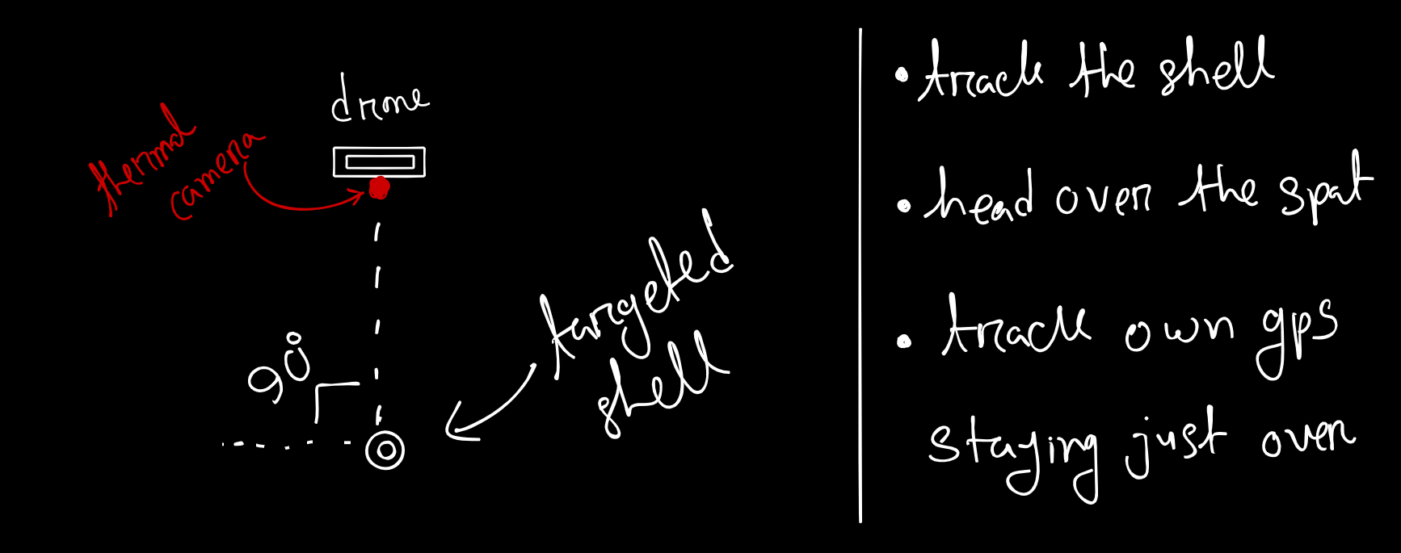
Get The GPS More Accurately

Slide 16
Make The Desired Format
GPS
Military Format

Slide 17
Got The Data Now ?
As there will be a pilot monitoring the drone so he can easily get the result of the system
He can also send the feedback to the firing troop via the media present now [radio]

Slide 18


